Slide 1
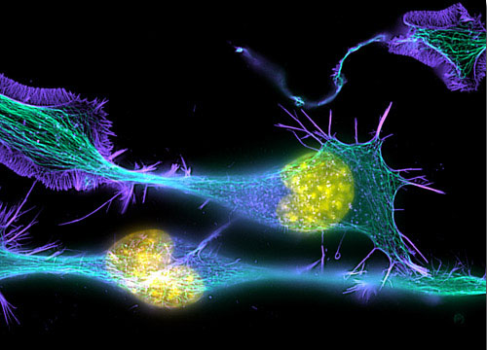
Introduction to
Light Microscopy
(Image: T. Wittman, Scripps)

Slide 2
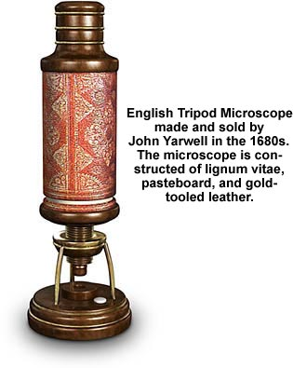
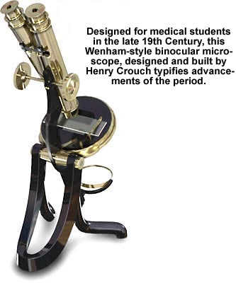
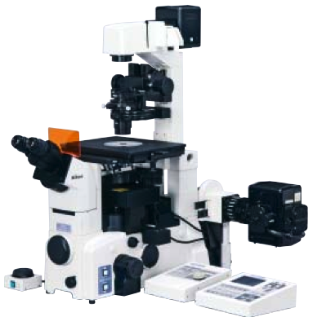
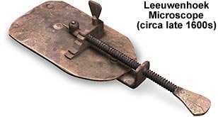
The Light Microscope
Four centuries of history
Vibrant current development
One of the most widely used research tools

Slide 3
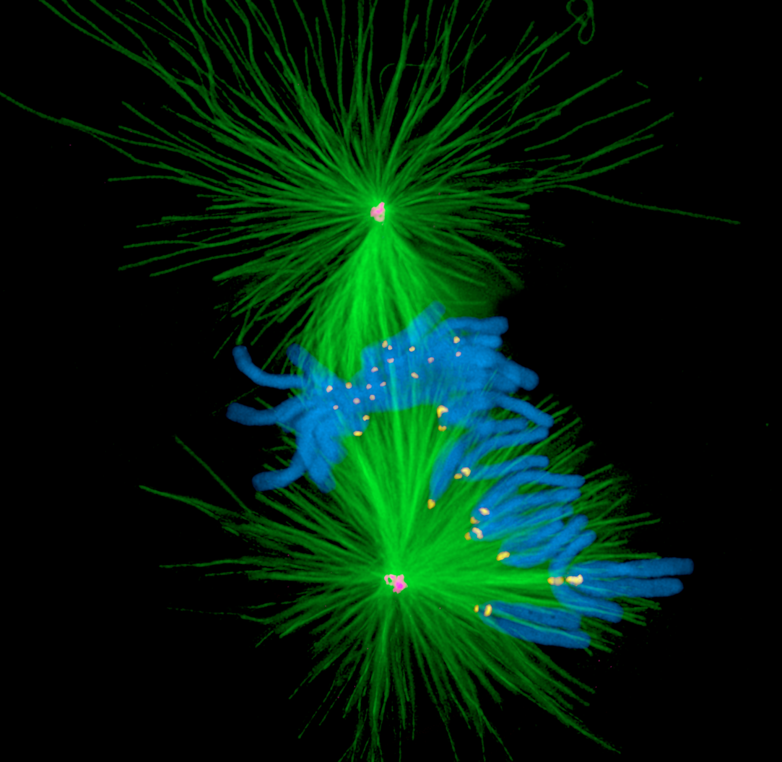
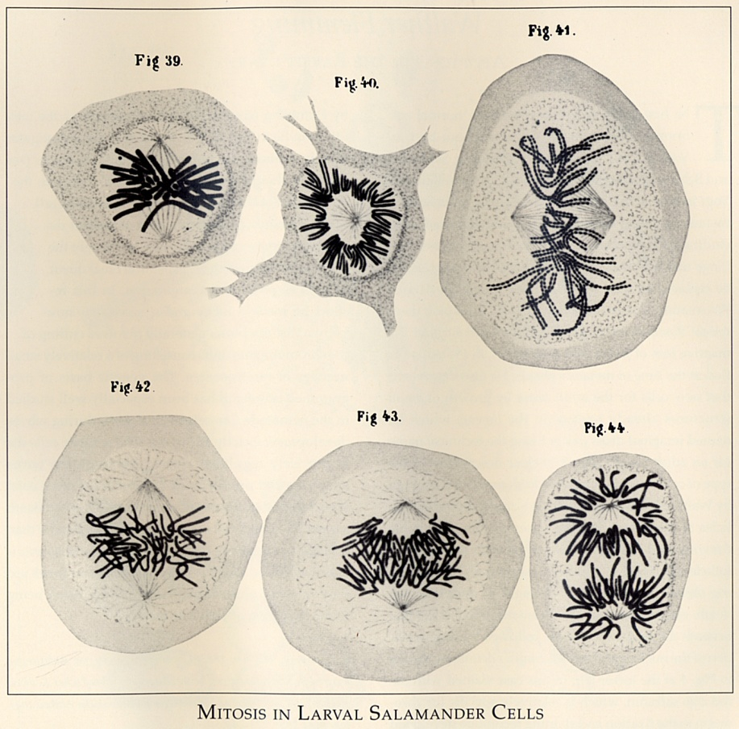
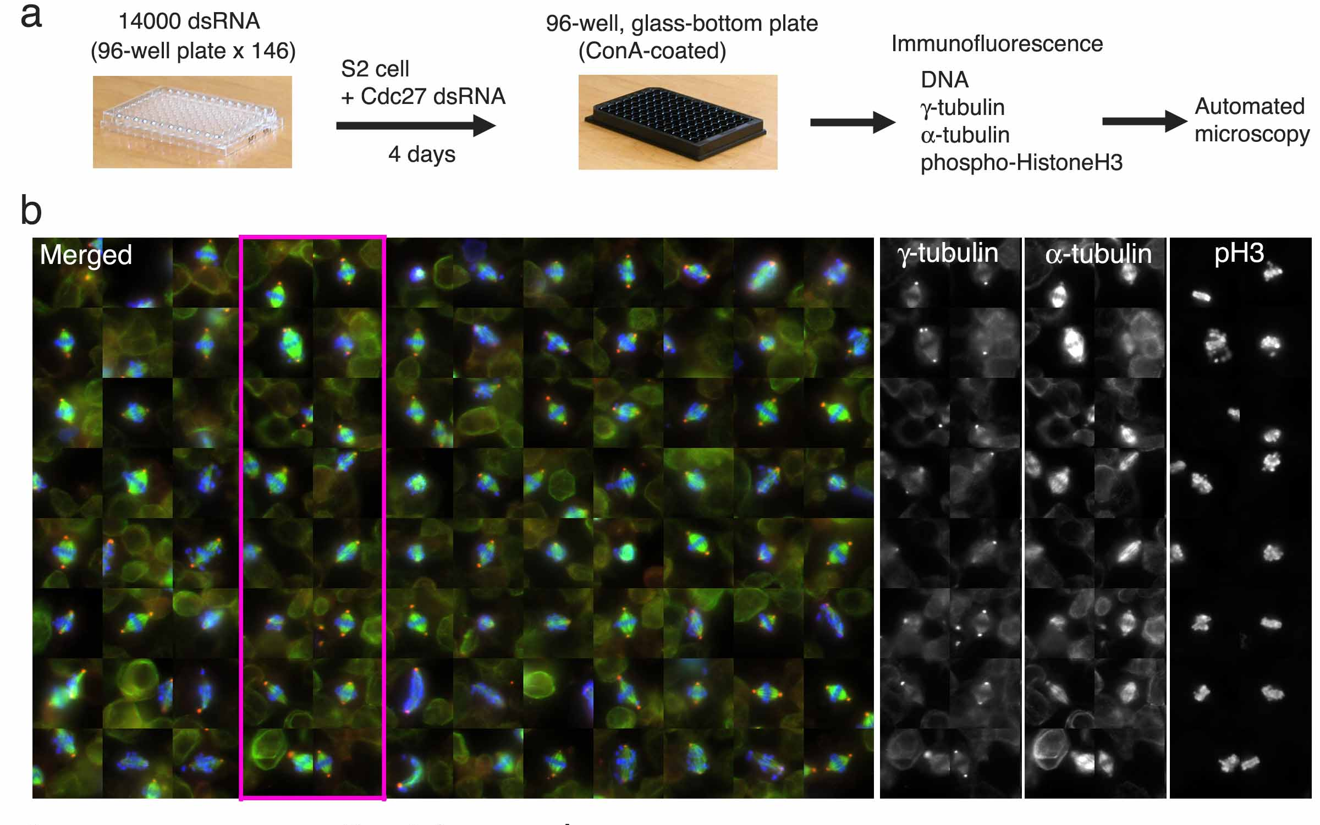
A. Khodjakov et al.

Slide 4
Major Imaging Functions of the Microscope
Magnify
Resolve features
Generate Contrast
Capture and Display Images

Slide 5
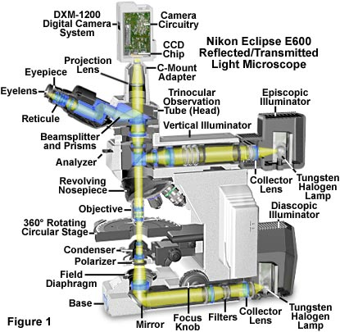
An Upright Epifluorescence Microscope

Slide 6
Light travels more slowly in matter
The speed ratio is the Index of Refraction, n
v = c/n
n = 1
n > 1
n = 1

Slide 7
Refractive Index Examples
Vacuum 1
Air 1.0003
Water 1.333
Cytoplasm 1.35–1.38 ?
Glycerol 1.475 (anhydrous)
Immersion oil 1.515
Fused silica 1.46
Optical glasses 1.5–1.9
Diamond 2.417
Depends on wavelength and temperature

Slide 8
Lenses work by refraction
Incident light
focus
Focal length f

Slide 9
Finite vs. Infinite Conjugate Imaging
Finite conjugate imaging (older objectives)
Image
f₀
Object
>f₀
f₀
Infinite conjugate imaging (modern objectives).
Image at infinity
f₁
⇒ Need a tube lens
Image
f₀
Object
f₀
f₀
(uncritical)
f₁
Magnification:

Slide 10
Back focal plane
Back focal plane
f₀
Object
f₀
f₀
Rays that leave the object with the same angle
meet in the objective’s back focal plane

Slide 11
The Compound Microscope
Exit pupil
Eyepiece
Primary or intermediate
image plane
Tube lens
Back focal plane (pupil)
Objective
Sample
Object plane

Slide 12
The Compound Microscope
Final image
Eye
Exit pupil
Eyepiece
Intermediate image plane
Tube lens
Back focal plane (pupil)
Objective
Sample
Object plane

Slide 13
The Compound Microscope
Final image
Eye
Exit pupil
Eyepiece
Intermediate image plane
Tube lens
Back focal plane (pupil)
Objective
Sample
Object plane

Slide 14
The Compound Microscope
Final image
Eye
Exit pupil
Eyepiece
Intermediate image plane
Tube lens
Back focal plane (pupil)
Objective
Sample
Object plane

Slide 15
The Compound Microscope
Final image
Eye
Exit pupil
Eyepiece
Intermediate image plane
Tube lens
Back focal plane (pupil)
Objective
Sample
Object plane

Slide 16
The Compound Microscope
Camera
Final image
Secondary pupil
Projection Eyepiece
Intermediate image plane
Tube lens
Back focal plane (pupil)
Objective
Sample
Object plane

Slide 17
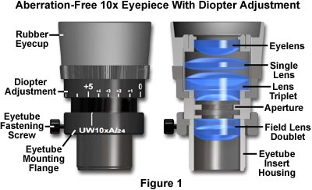
Eyepieces (Oculars)
Features
Magnification (10x typical)
“High eye point” (exit pupil high
enough to allow eyeglasses)
Diopter adjust (at least one
must have this)
Reticle or fitting for one
Eye cups

Slide 18
Trans-illumination Microscope
Camera
Final image plane
Secondary pupil plane
Projection Eyepiece
Imaging
path
Intermediate image plane
Tube lens
Back focal plane (pupil)
Objective
Sample
Object plane
Condenser lens
The aperture iris
controls the range of
illumination angles
Aperture iris
(pupil plane)
Illumination
path
Field lens
Field iris
(image plane)
The field iris
controls the
illuminated
field of view
Collector
Light source
(pupil plane)

Slide 19
Köhler Illumination
Critical Illumination
Sample
Object plane
Aperture iris
(pupil plane)
Field iris
(image plane)
Light source
(pupil plane)
Each light source point produces a parallel beam of light at the sample
Uniform light intensity at the sample even if the light source is “ugly” (e.g. a filament)
The source is imaged onto the sample
Usable only if the light source is perfectly uniform

Slide 20
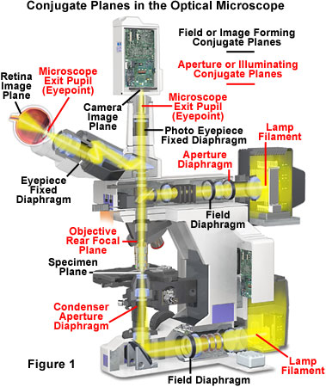
Conjugate Planes in A Research Microscope

Slide 21
How view the pupil planes?
Two ways:
“Eyepiece telescope”
“Bertrand lens”

Slide 22
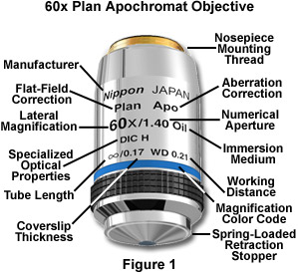
By far the most important part: the Objective Lens
Each major manufacturer sells 20-30 different categories of objectives.
What are the important distinctions?

Slide 23
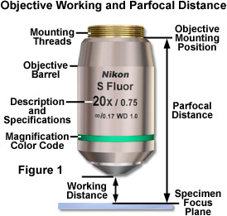
Working Distance
In general, high NA lenses have short working distances
However, extra-long working distance objectives do exist
Some examples:
10x/0.3 WD = 15.2mm
20x/0.75 WD = 1.0mm
100x/1.4 WD = 0.13mm

Slide 24
The focal length of a lens depends on the refractive index…
Refractive index n
Focal length f
f ∝ 1/(n-1)

Slide 25
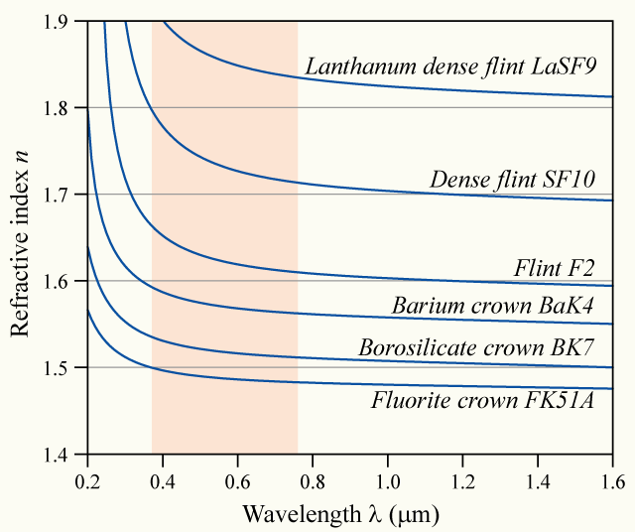
… and the refractive index depends on the wavelength (“dispersion”)
Glass
types

Slide 26
⇒ Chromatic aberration
Different colors get focused to different planes
Not good…

Slide 27
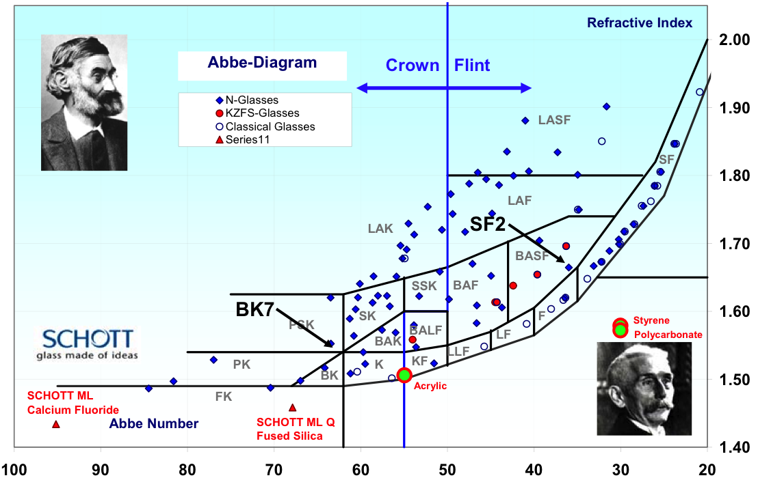

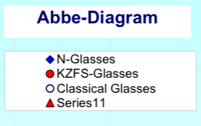

Dispersion vs. refractive index of different glass types
Refractive
index
Abbe dispersion number
(Higher dispersion→)

Slide 28
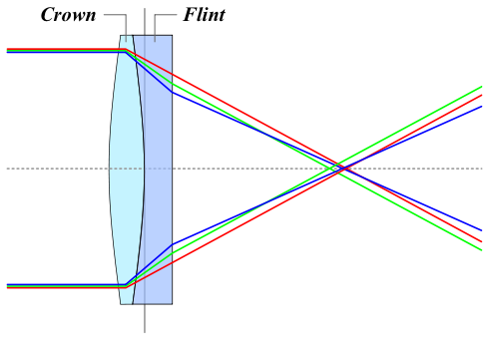
Achromatic Lenses
Use a weak negative flint glass element
to compensate the dispersion of a
positive crown glass element

Slide 29
Achromats and Apochromats
Focal length error
Wavelength
Apochromat (≥3 glass types)
Achromat (2 glass types)
Simple lens

Slide 30
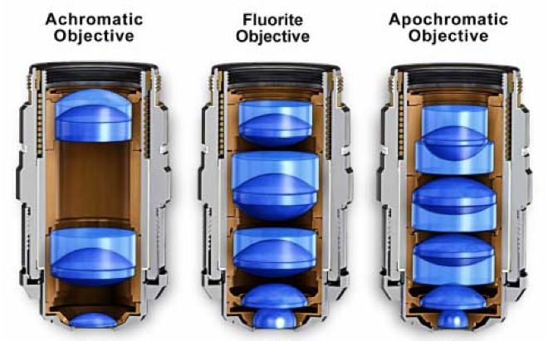
Correction classes of objectives
Achromat (cheap)
Fluor “semi-apo” (good correction, high UV transmission)
Apochromat (best correction)
Correction for other (i.e. monochromatic) aberrations also improves in the same order

Slide 31
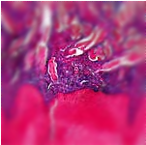
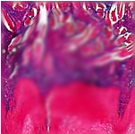
Curvature of Field
Focal plane
Focal plane Focal surface
Tube lens
objective
sample
Focal
surface

Slide 32
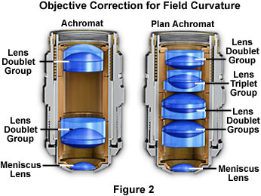
Plan objectives
Corrected for field curvature
More complex design
Needed for most photomicrography
Plan-Apochromats have the highest performance
(and highest complexity and price)

Slide 33
What is the Resolution Limit of an Objective?
i.e. what is the smallest separation between two objects you can detect?

Slide 34
Diffraction by a periodic structure (grating)

Slide 35
Diffraction by a periodic structure (grating)
θ
θ
d
d Sin(θ)
In phase if:
d Sin(θ) = m λ
for some integer m

Slide 36
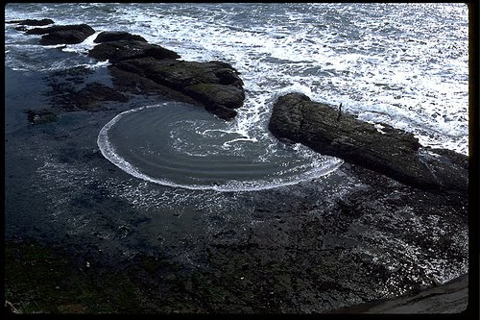
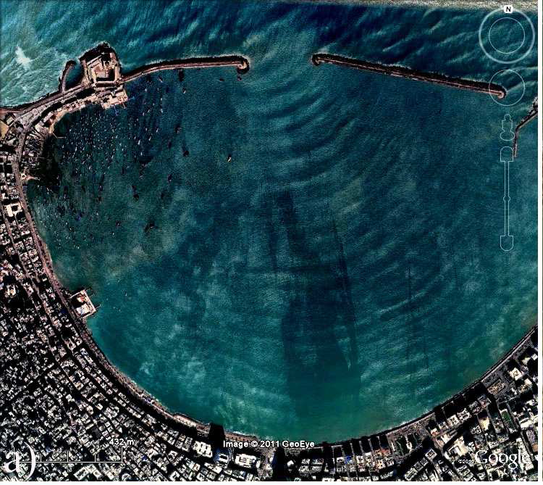
Diffraction by an aperture
See “Teaching Waves with Google Earth” http://arxiv.org/pdf/1201.0001v1.pdf for more

Slide 37
Diffraction by an aperture
drawn as waves
Light spreads to new angles
Larger aperture
⇔
weaker diffraction

Slide 38
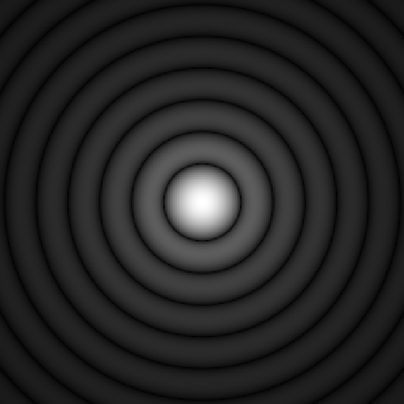
Diffraction by an aperture
drawn as rays
The pure, “far-field”
diffraction pattern
is formed at ∞ distance…
Tube lens
…or can be formed
at a finite distance
by a lens…
Intermediate
image
…as happens in a microscope
Objective pupil

Slide 39
The Airy Pattern
= the far-field diffraction pattern from a round aperture
Height of
first ring
≈ 1.75%
“Airy disk” diameter
d = 2.44 λ f/d
(for small angles d/f)
d
f

Slide 40
Aperture and Resolution
Diffraction spot
on image plane
= Point Spread Function
Intermediate image plane
Objective
Tube lens
Sample
Back focal plane aperture

Slide 41
Aperture and Resolution
Diffraction spot
on image plane
= Point Spread Function
Intermediate image plane
Objective
Tube lens
Sample
Back focal plane aperture

Slide 42
Aperture and Resolution
Diffraction spot
on image plane
= Point Spread Function
Intermediate image plane
Objective
Tube lens
Sample
Back focal plane aperture

Slide 43
Aperture and Resolution
Diffraction spot
on image plane
(resolution)
Intermediate image plane
Objective
Tube lens
Sample
α
Back focal plane aperture
Image resolution improves with aperture size
Numerical Aperture (NA)
NA = n sin(α)
= light gathering angle
n = refractive index of sample
where:

Slide 44

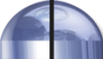
Numerical Aperture
100X / 0.95 NA
α = 71.8°
4X / 0.20 NA
α = 11.5°

Slide 45
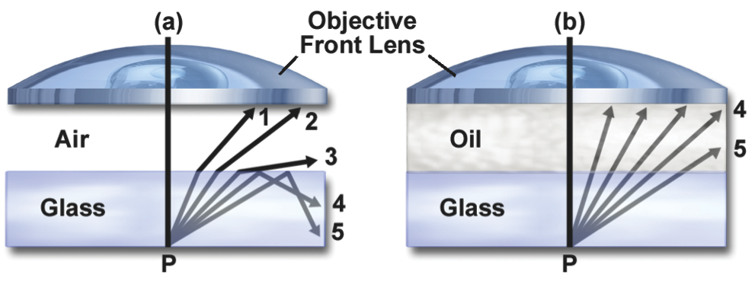
Immersion Objectives
NA cannot exceed
the lowest n between the
sample and the objective lens
NA >1 requires fluid immersion
Oil immersion:
n ≈ 1.515
max NA ≈ 1.4 (1.45–1.49 for TIRF)
Glycerol immersion:
n ≈ 1.45 (85%)
max NA ≈ 1.35 (Leica)
Water immersion:
n ≈ 1.33
max NA ≈ 1.2
NA can approach
the index of the
immersion fluid

Slide 46
Resolution
Ernst Abbe’s argument (1873)
Consider a striped sample ≈ a diffraction grating
Back focal
plane
Objective lens
β
Diffracted beams
d sin(β) = λ
Sample
Smaller d
→ larger β
d
Condenser
Light source
Consider first
a point light source
If β > α, only one spot makes it through
⇒ no interference ⇒ no image formed
Resolution (smallest resolvable d):
dmin = λsample/sin(α) = λ/n sin(α) = λ/NA

Slide 47
(Abbe’s argument, continued)
Now consider oblique illumination
(an off-axis source point):
One spot hopelessly lost,
but two spots get through
→ interference → image formed!
βout
d [sin(βin) + sin(βout) ] = λ
βin
Two spots get through if
βout < α and βin < α.
d
Resolution (smallest resolvable d)
with incoherent illumination (all possible illumination directions):
dmin = λ/(NAobj + NAcondenser )
λ/2 NA if NAcondenser ≥ NAobj (“Filling the back focal plane”)

Slide 48
Aperture, Resolution & Contrast
Can adjust the condenser NA with the aperture iris
Imaging
path
Intermed. image
Tube lens
Back aperture
Objective
Q: Don’t we always want
it full open??
A: No
Why? Tradeoff:
resolution vs. contrast
Sample
Condenser lens
Aperture iris
Field lens
Illumination
path
Field iris
Collector
Light source

Slide 49
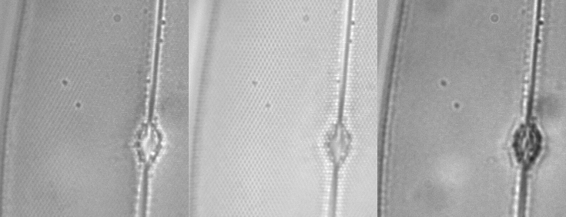
NA and Resolution
High NA Objective Low NA Objective

Slide 50
Alternate Definitions of Resolution
As the Full Width at Half Max
(FWHM) of the PSF
FWHM
≈ 0.353 λ /NA
As the diameter of the Airy disk
(first dark ring of the PSF)
= “Rayleigh criterion”
(Probably most common definition)
Airy disk radius
≈ 0.61 λ /NA

Slide 51
Objective Types
Field flatness
Plan or not
Phase rings for phase contrast
Positive or negative
Diameter of ring (number)
Special Properties
Strain free for Polarization or DIC
Features
Correction collar for spherical aberration
Iris
Spring-loaded front end
Lockable front end
Basic properties
Magnification
Numerical Aperture (NA)
Infinite or finite conjugate
Cover slip thickness if any
Immersion fluid if any
Correction class
Achromat
Fluor
Apochromat

Slide 52
Further reading
www.microscopyu.com
micro.magnet.fsu.edu
Douglas B. Murphy “Fundamentals of Light Microscopy and Electronic Imaging”
James Pawley, Ed. “Handbook of Biological Confocal Microscopy, 3rd ed.”
Acknowledgements
Ron Vale / Mats Gustafsson

